Slide 1
Physical activity and mortality in the elderly
Tianran Zhang

Slide 2
Introduction
3075 participants, aged 70 to 79 years from a random sample of white Medicare beneficiaries and all age-eligible black community residents to participate in the Health, Aging, and Body Composition (Health ABC) study. (1997 - 1998)
Eligibility criteria included self-reporting no difficulty in walking a distance of 0.4 km or climbing at least 10 stairs, independently performing activities of daily living, plans to live in the area for the next 3 years, and no evidence of life-threatening illnesses. An energy expenditure sub-study carried out in 1998-1999 enrolled 302 individuals.
Among these individuals, free-living activity energy expenditure over a two-week period was assessed using an accurate and objective measure based on doubly labeled water and indirect calorimetry. This measure captures both resting metabolic rate and total energy expenditure.
Vital status was ascertained by telephone contact every 6 months over an 8-year period (1998-2006). Date of death was verified with death certificates. Body fat was measured at the first energy expenditure visit. The following self-reported medical conditions (assessed at first visit) were confirmed by treatment and/or medication: cardiovascular disease (hypertension, coronary heart disease, myocardial infarction, and stroke), lung disease, diabetes, hip or knee osteoarthritis, osteoporosis, cancer, and depression and were updated at the at the first energy expenditure visit. Smoking behavior was assessed during the first Health ABC annual clinic visit in 1997-1998.

Slide 3
Step 0: Specify the scientific question
What is the effect of free-living energy expenditure on the seven-year survival among older active adults.

Slide 4
Introduction
Male circumcision in the prevention of heterosexual female-to-male HIV transmission has received considerable attention throughout sub-Saharan Africa.
Public health stake holders are considering future policy recommendations regarding circumcision alone or in combination with other prevention measures in reducing the HIV burden in sub-Saharan Africa.
Generalizability of RCT results and experiences to populations with unique cultural and epidemiologic characteristics must be fully considered in the planning of any widespread prevention initiative.

Slide 5
Step 1: Specify the Structural Causal Model (SCM)
Endogenous variables: X=(W,A,Y);
Exogenous variables: U=(U_W, U_A, U_Y)∼P∗;
Structural equations F:
W←fW(UW)
A←fA(W,UA)
Y←fY(W,A,UY)
W={smoking, comorbidities, body fat},
A={energy expenditure}
Y={survival}.
Check causal assumptions
Exclusion restrictions: No
Independence assumptions: No

Slide 6
Step 2: Specify the causal parameter
The target causal parameter is the difference in the counterfactual probability of survival if all elderly persons had a high energy expenditure (A=1) and the counterfactual probability of survival if all elderly persons had a low energy expenditure(A=0)
ATE (average treatment effect): θ∗=E∗(Y1)−E∗(Y0)
Counterfactual outcome Ya: the seven-year survival for an individual if, possibly contrary to fact, the individual had energy expenditure A=a for this two-week period.

Slide 7
Step 3: Specify the observed data & its link to the causal model
The observed data: O=(W,A,Y)∼ P
Link the observed data to the causal model
The observed data were generated by sampling n independent times from a data generating system described by the structural causal model (SCM), which would yield n iid observations: O1, O2, ..., On iid ~ P
The statistical model: the set of possible distributions for the observed data.
SCM does not place any restrictions on it: non-parametric.

Slide 8
Step 4: Identify: Knowledge + data sufﬁcient?
In the original SCM, the target causal parameter is not identified from the observed data distribution.

Slide 9
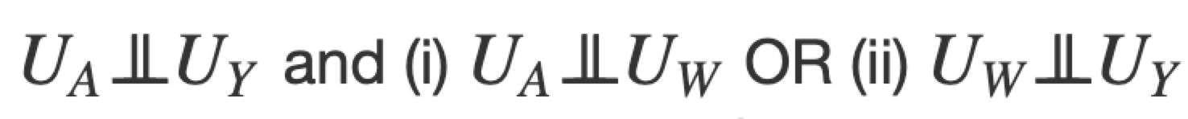

Step 4: Identify: Knowledge + data sufﬁcient?
Suppose the investigators assume no unmeasured common causes of (W,A,Y) This is sufficient, but not necessary for identifiability.

Slide 10
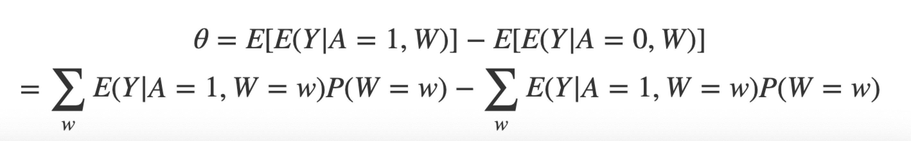
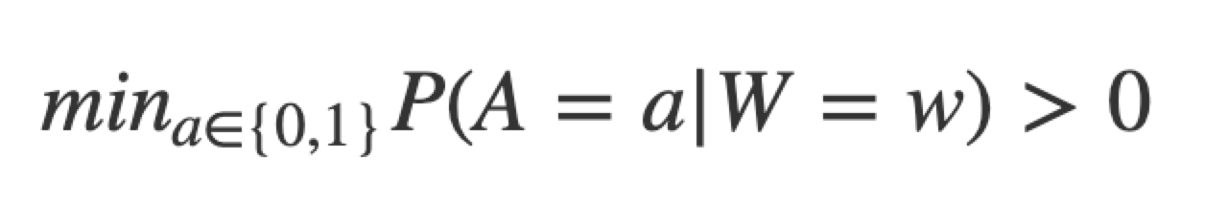
Step 5 Commit to an estimand as close to question as possible, and a statistical model representing real knowledge
Target statistical estimand:
Positivity assumption:
for all w for which P(W=w)>0. We need that each possible exposure level is represented in every covariate strata. This condition on data support ensures that our statistical estimand is well-defined.

